Slide 1
Data and Applied Sciences: GenAI Portfolio
SX/EDS-MM
Notes:
Whatever we presented to BCI
PT use cases (GenAI)
Formation of Incubation team and kick off

Slide 2
























































Data and Applied Sciences
Bosch Center for Data Science
Generative AI
Bosch.Genius, Conversational AI, Recommendation Engines,
Generation
Data Entry, Data Acquisition, Machines in Smart Factories
8
1
1200+
Tech Experts
Interactive Visual Exploration
Advanced Data Visualizations
Data Storytelling, Augmented Analytics, Self Service Reports, Decision Intelligence
Collection
Anonymization, Pose Estimation, Polygon Annotation, Synthetic Data Generation, Key Point Annotation
250+
Digital Transformation & AI use cases
7
2
Data Lifecycle
Data Science
Explainable AI, MLOps, Ethical AI, Adaptive AI, Auto ML, Reinforcement Learning, AIOps, Responsible AI
Processing
Data Ingestion / Data Migration / Data Pipelines, ETL / ELT, Aggregations, Data Ops
450+
Success Stories
3
6
550+
Certified Associates
AIoT & Robotics
Smart Ecosystems, Dynamic optimization, IoT operations, Edge AI
Storage
Lake house, Data Fabric, Datawarehouse, Enterprise Data Lake, Data Modelling
5
4
47+
Invention Reports
Partners
Clients

Slide 3
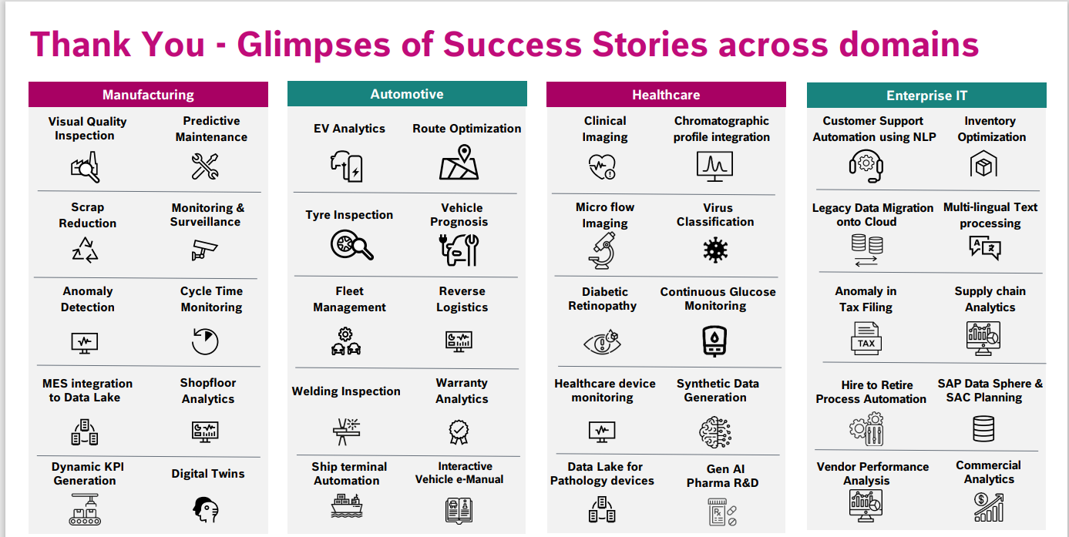
Glimpses of Our Success Stores Across Domains
Notes:
Scrap reduction – Recipe recommendation (can relate to

Slide 4











Gen AI as a Service
Data and Applied Sciences
110+
Gen AI Specialists
20+
Success Stories
Tech Stack
Assessment Agents
Field Service Agents
RFP Compliance, Risk assessment, policy monitoring
AI powered diagnostics, Predictive maintenance scheduling, remote assistance
Data Insight Agents
Employee Service Agents
Dynamic KPI Generation, Predictive Analytics, Customer behavior analytics
HR Helpdesk, Onboarding assistance, Project status, Travel Assistance
Powered by
Generative AI
Customer Support Agents
Engineering Agents
Contextual Chatbots, Multi-lingual support, Proactive assistance
Efficiency | Experience | Effectiveness
Code Generation, Code conversion, Bug detection and fixing
Platform | Models | Infrastructure
Notes:
Efficiency, Experience and Effectiveness

Slide 5
Data and Applied Sciences
Gen AI – Connected Ecosystems
Engineering Efficiency
Quality and Regulations
Process Simulations
Predictive Maintenance
Deployment and Support
Requirement Eng.
Code to Unit Test
MISRA Code Compliance Assist
Image Labeling
AI Driven Pump Calibration
Pharmacopeia
Auto E-Manuals
Sure.AI
Docupedia Data Management
FMEA
Dynamic KPI for Production
Hardware Component Evaluation with GenAI, DAR
Gen AI for Safety relevance
Dynamic KPI for Production
Gen AI for Industry – IndAIGenious
AI Powered Customer and Tech support
Application configuration
Knowledge management
Data Insights
Recommendation
GenAI “INSIGHTS” : Consulting as a Horizontal
Notes:
Deployment and Support
Application configuration
Knowledge base support
Data Insights
Recommendation
Consulting as a Horizontal

Slide 6
Knowledge Nexus

Slide 7
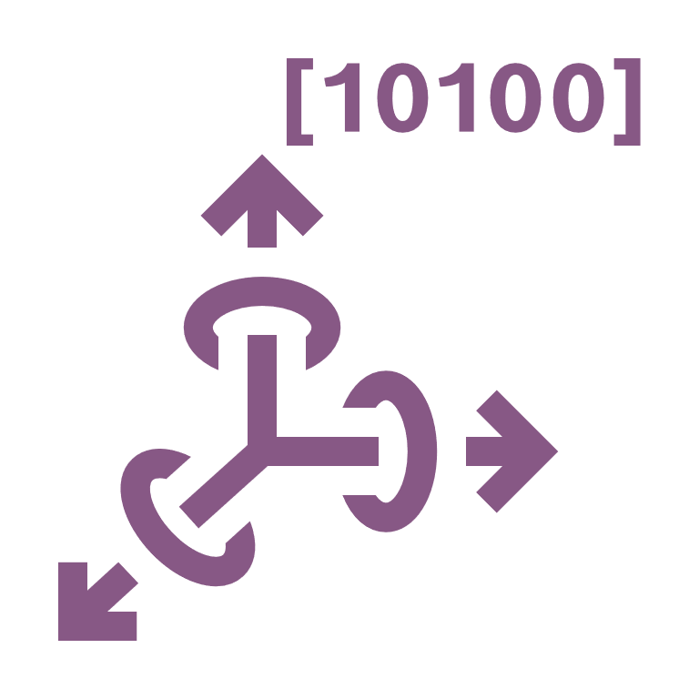







Our Solution: Knowledge Nexus
Overview:
A cutting-edge platform designed to transform organizational
decision-making processes.
Insight Generation:
Transforms complex data into concise summaries.
Provides actionable insights for quick and efficient
decision-making.
Real-Time Information Extraction:
Integrates advanced document analysis with conversational AI.
Allows users to extract critical information in real time.
All-in-One Solution:
Merges multiple tools into a single, comprehensive platform.
Eliminates the need for using various separate tools.
Industry Versatility:
Supports various industries that handle large volumes of information.
Tailored to meet the unique needs of diverse sectors.
Vector DB
Embeddings
Generation
Retrieval Augmented
Generation
Loop
Knowledge Nexus
BOSCH
Documents
LLM Model
Create New Project
User Chat Interface

Slide 8







Data and Applied Sciences
Knowledge Nexus – Key Features
RAG & Hybrid-RAG Querying
Besides RAG sources,
KN can collate information from non-RAG sources
such as SQL DBs to synthesize answers
Agentic Framework
Agentic Framework available to customize
and enhance Information retrieval sequence.
Multi-Modality
Supports wide-variety of data formats ranging
from Text, Image, Video and Speech for
Querying and Retrieval.
LLM Agnostic
Platform seamlessly integrates with Local and
Industry grade LLM Models as per the
User preference.
Knowledge Nexus
External Plugins
Connections available to existing AI Workflows
And Tools via Simple API calls.
User Personas
Multiple User Personas available to enhance
and personalize the User Experience.
Cloud Friendly
Data Privacy
DIY Workflow
Notes:
Deployment and Support
Application configuration
Knowledge base support
Data Insights
Recommendation
Consulting as a Horizontal

Slide 9
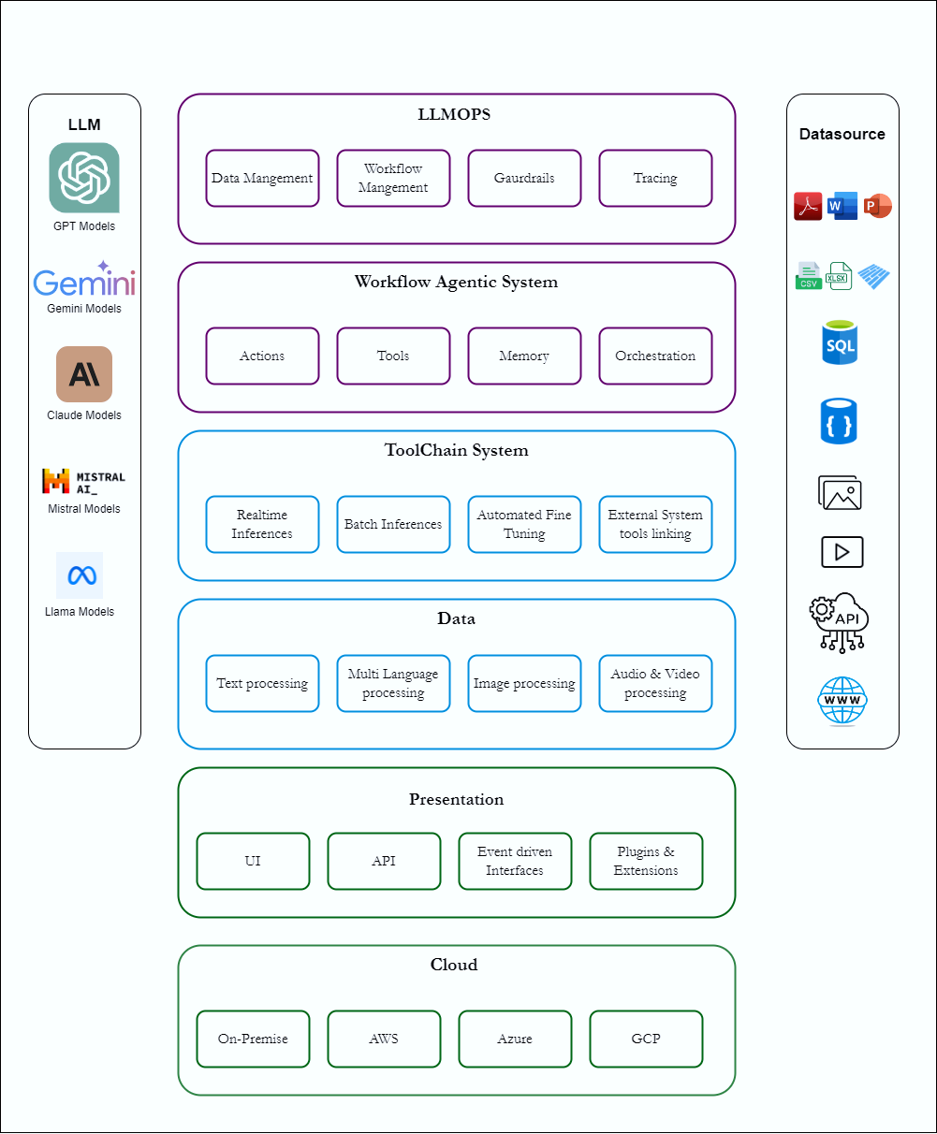
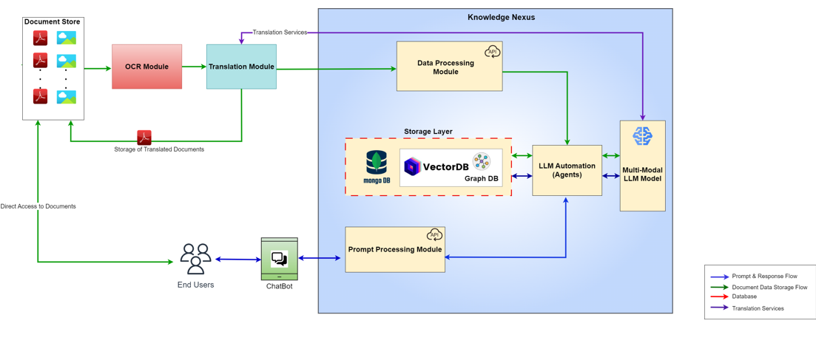
Data and Applied Sciences
Knowledge Nexus
Notes:
Deployment and Support
Application configuration
Knowledge base support
Data Insights
Recommendation
Consulting as a Horizontal

Slide 10
Generative AI Case Studies

Slide 11
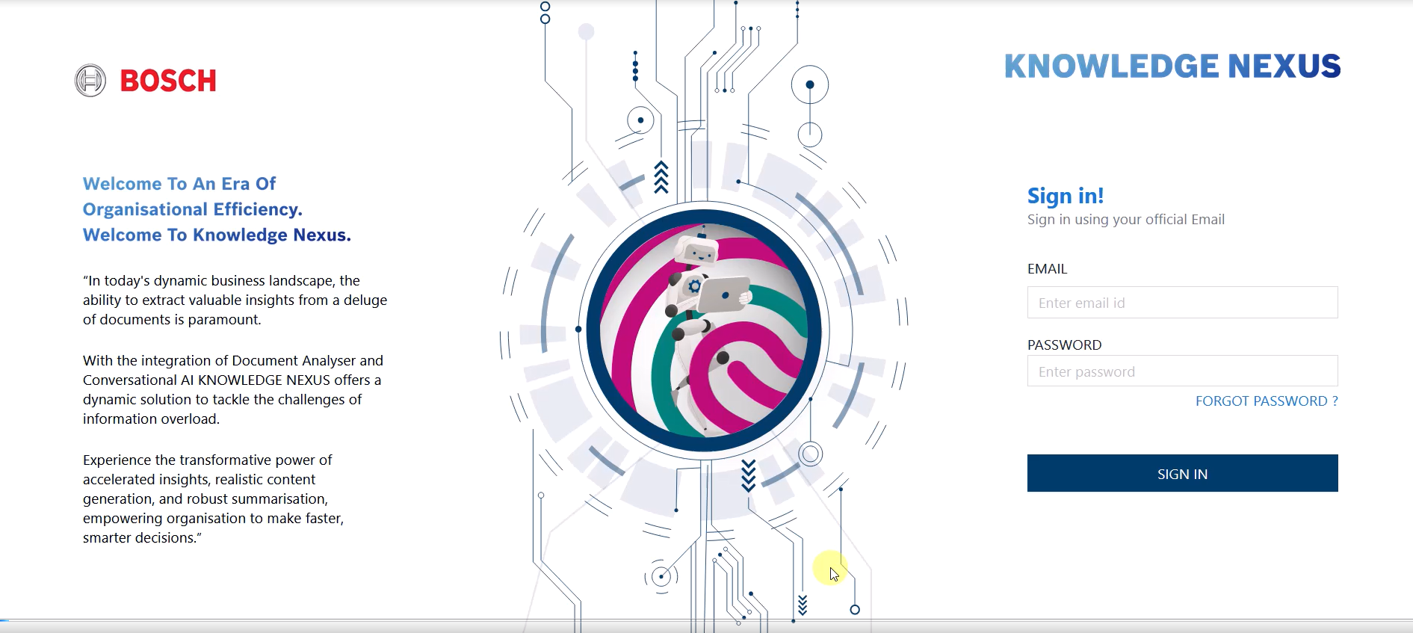
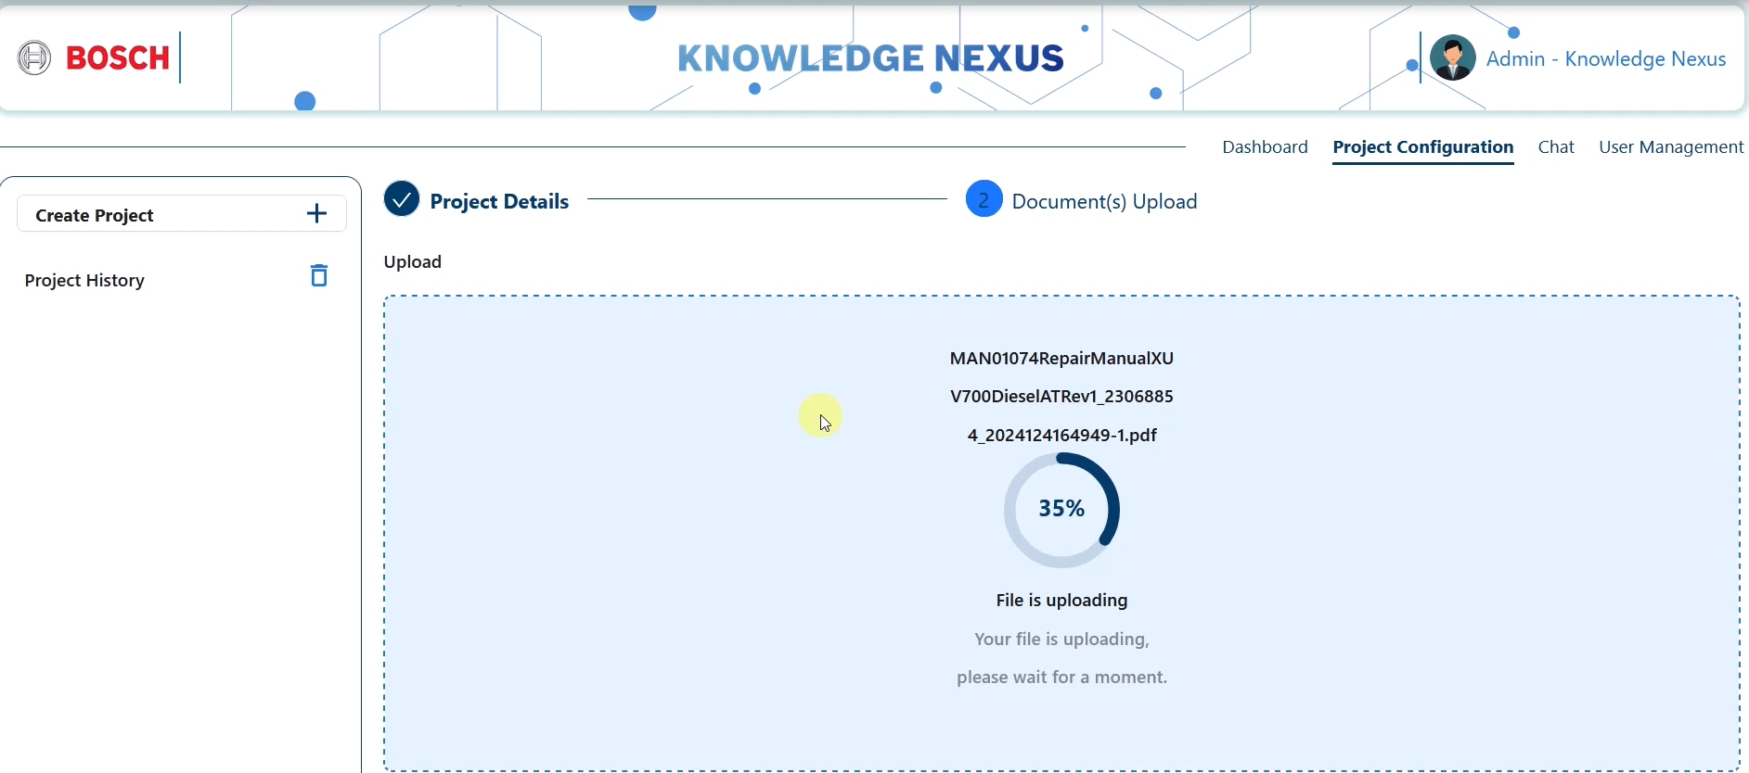


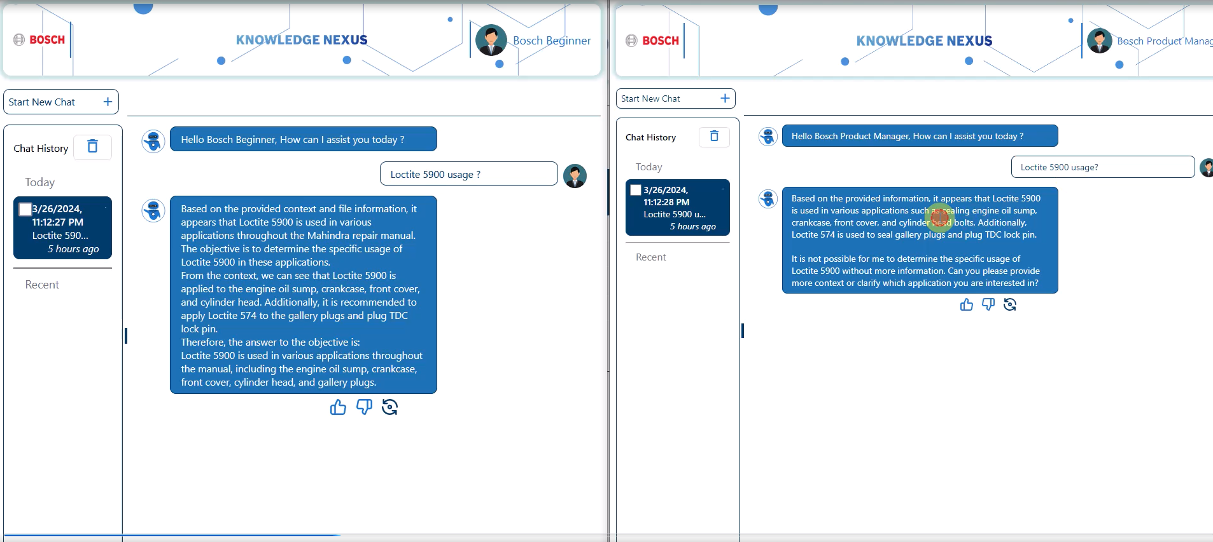
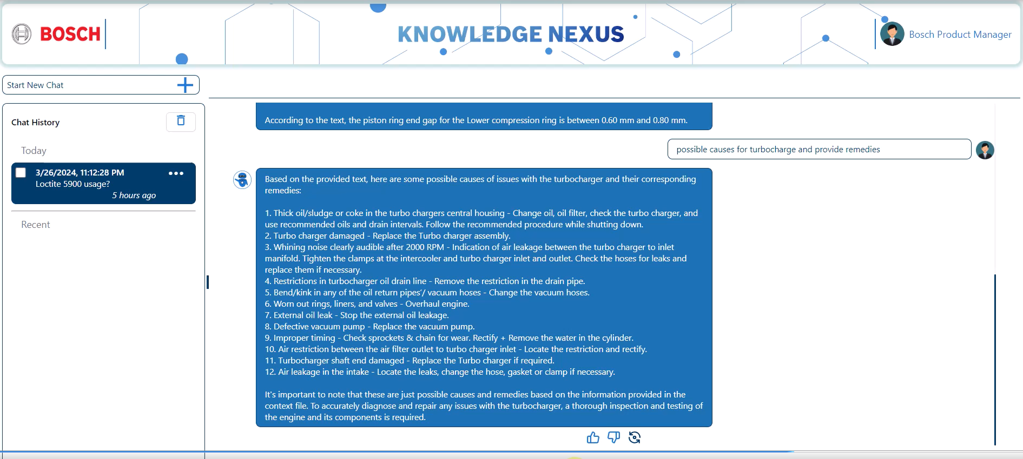


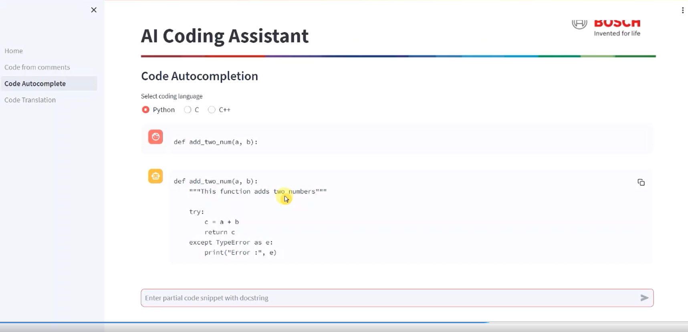
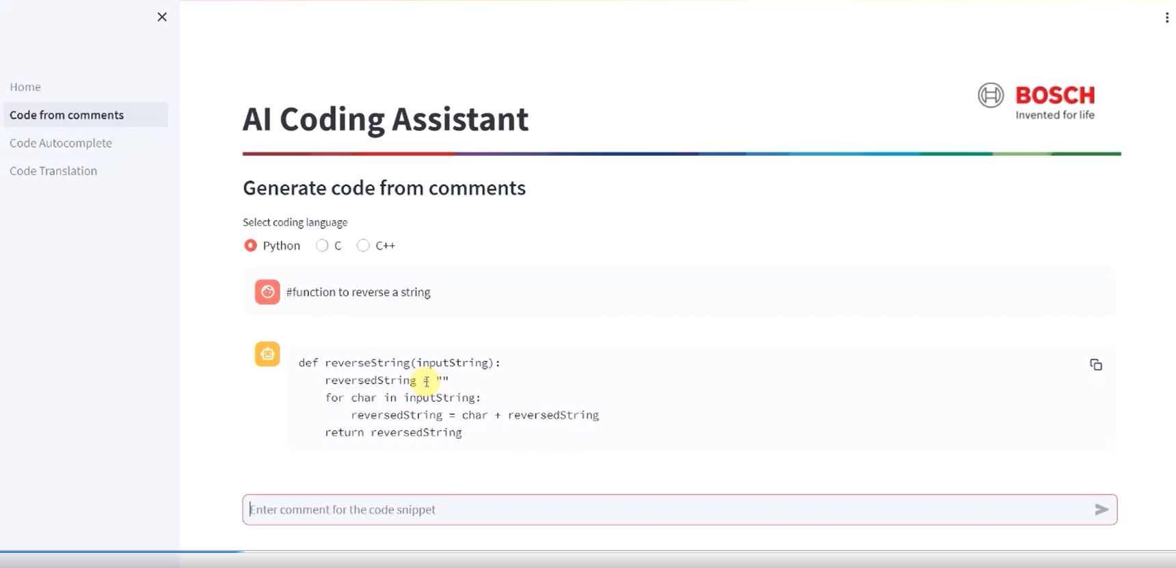
Bosch.Genius
A Genius Suite of Generative AI Solutions, Powered by BGSW
A Sneak Peek into Bosch.Genius
Success Stories
Contextual chatbot for medical research professionals for Q&A, Summarization & more, estimated to save >80% efforts
Complex solution to derive KPIs such as OEE, forecasting, utilization & advanced reasoning from real time plant data
Autonomous vehicle operations for off-highway vehicles leading to time to market improvement by up-to 60%
E-manual solution customized to multiple user personas for a step-by-step probe into vehicle malfunction and repair
Smart classifier to automatically detect functional safety requirements, reducing manual efforts by up-to 95%

Slide 12










E-Manuals for Automotive
Client was looking to digitize manuals of its vehicle models leveraging the power of Gen AI.
Developed a Gen AI based application that lets users interact and retrieve contextual information regarding their vehicles. The application also diagnoses any errors and helps troubleshoot in an accelerated manner
Accelerated diagnosis by up-to 80%
Improved customer satisfaction through human-like interactions
Reduced service center visits through smart diagnosis
Notes:
BU: Mobility Electronics (ME)
Plants: CljP, JuP, NhP1
Line Type: SMT
Product Team: PT-SMT
Data: Productivity (Utilization, Downtimes, Cycle Times, Parts Produced)

Slide 13
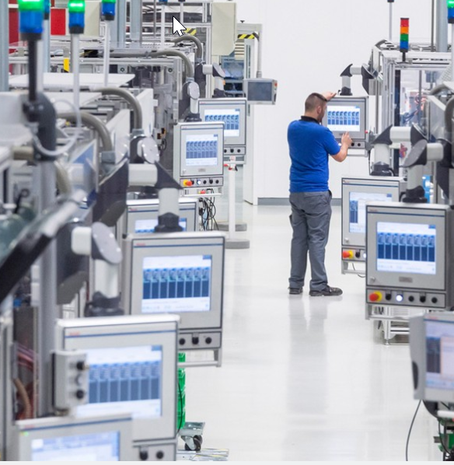





AI-Driven Pump Calibration Support
Client was looking for an AI-powered recommendation system to assist technicians in diagnosing and resolving defects efficiently, reducing the manual effort involved and standardizing the repair process across technicians.
Developed an AI-driven recommendation system that:
Delivers real-time, step-by-step guidance and recommendations to technicians based on defect patterns and possible fix.
Standardized defect resolution, ensuring consistency across technician experience.
Supported the resolution of 200+ defects in pump calibration.
Saved 15-20% effort per defect fix, enhancing overall efficiency.
Standardized the repair process,
reducing variability in technician output.

Slide 14
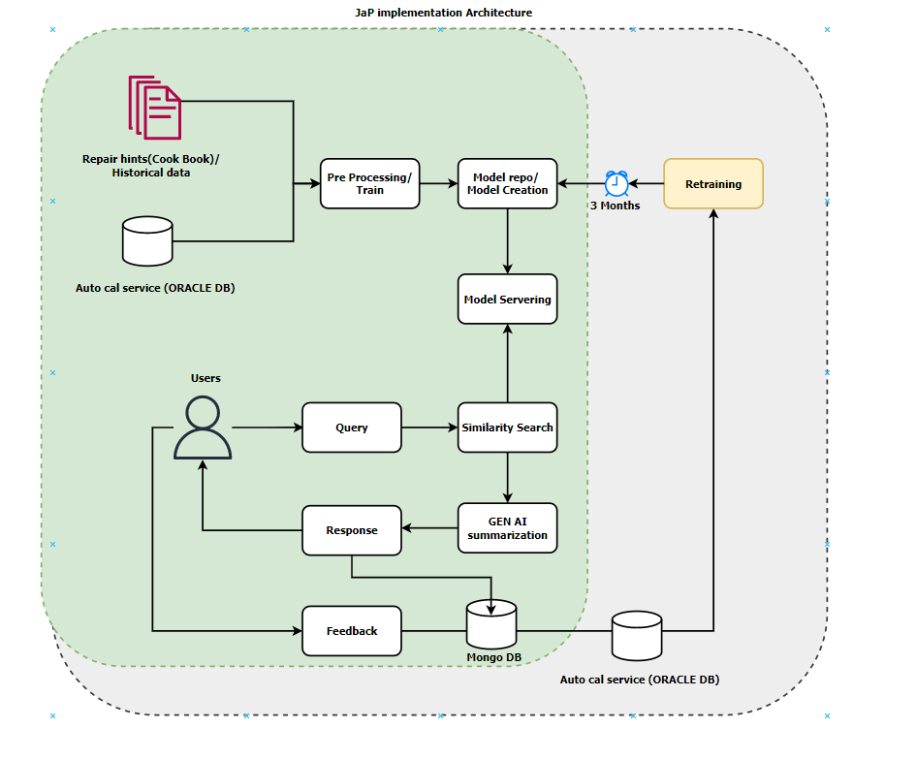
Architecture

Slide 15
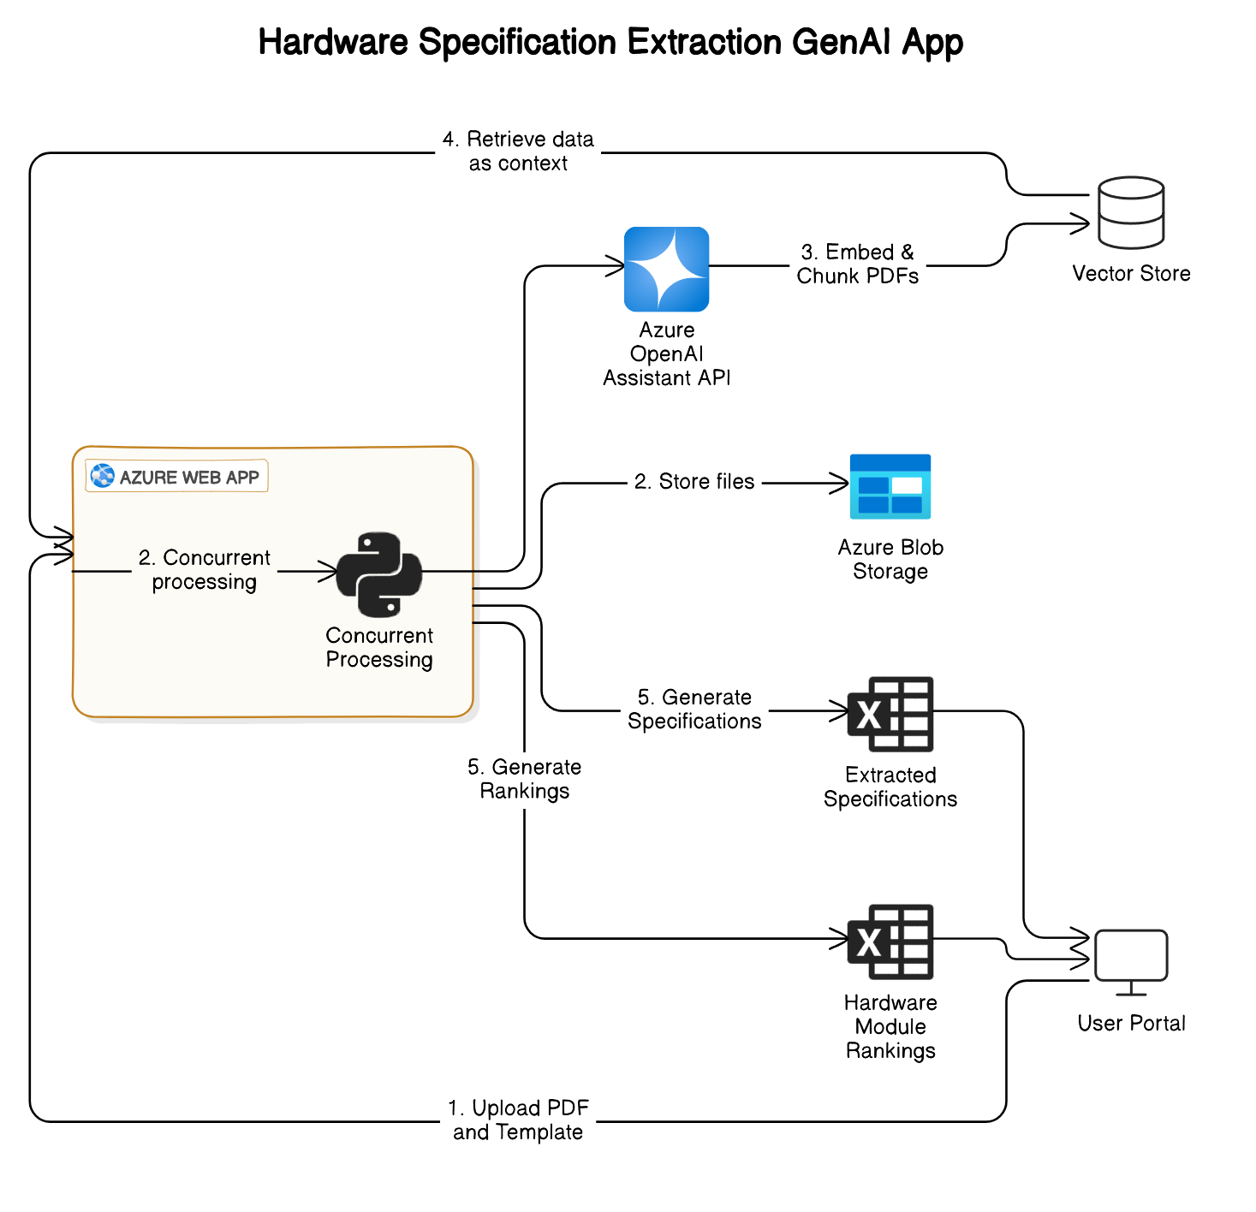




Hardware Component Evaluation with
GenAI
Client Need was looking for a solution to automate the extraction and comparison of hardware specifications tailored to user-defined criteria.
Developed a GenAI-powered solution that :-
Automates the extraction of hardware specifications from multiple documents, simplifying the comparison process.
Leverages the Azure OpenAI Assistants API to analyze, rank, and present components based on specific user requirements.
Significantly reduction in evaluation time
Improved accuracy in component selection
Enables users to quickly identify
the most suitable hardware for
their use case
Notes:
DAR Analysis

Slide 17


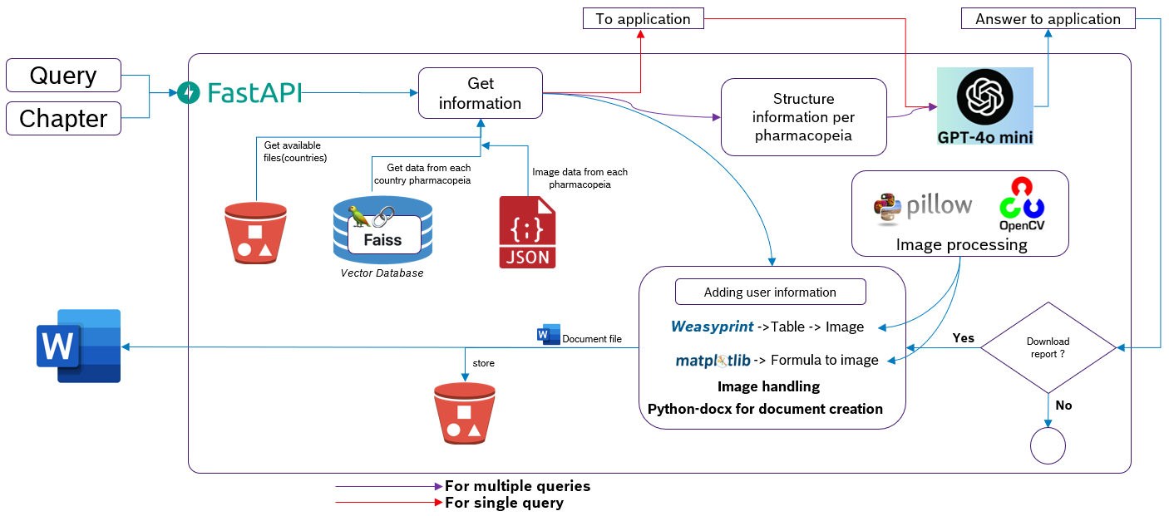





Expedited Pharma R&D using Gen AI
Sifting through Pharmacopeia documents is a time consuming and effort intensive task for R&D associates. Client was looking to harness the power of Gen AI for a contextual chatbot, smart summarization and document comparisons.
Developed an OpenAI based application that enabled client to streamline their R&D process with the faster TAT and reduced errors.
Trained over 100+ Pharmacopeia documents
Efforts needed to analyze the documents are expected to be down by 90%
Enabled quick references to regulatory documents
Notes:
BU: Mobility Electronics (ME)
Plants: CljP, JuP, NhP1
Line Type: SMT
Product Team: PT-SMT
Data: Productivity (Utilization, Downtimes, Cycle Times, Parts Produced)

Slide 18
Architecture

Slide 19
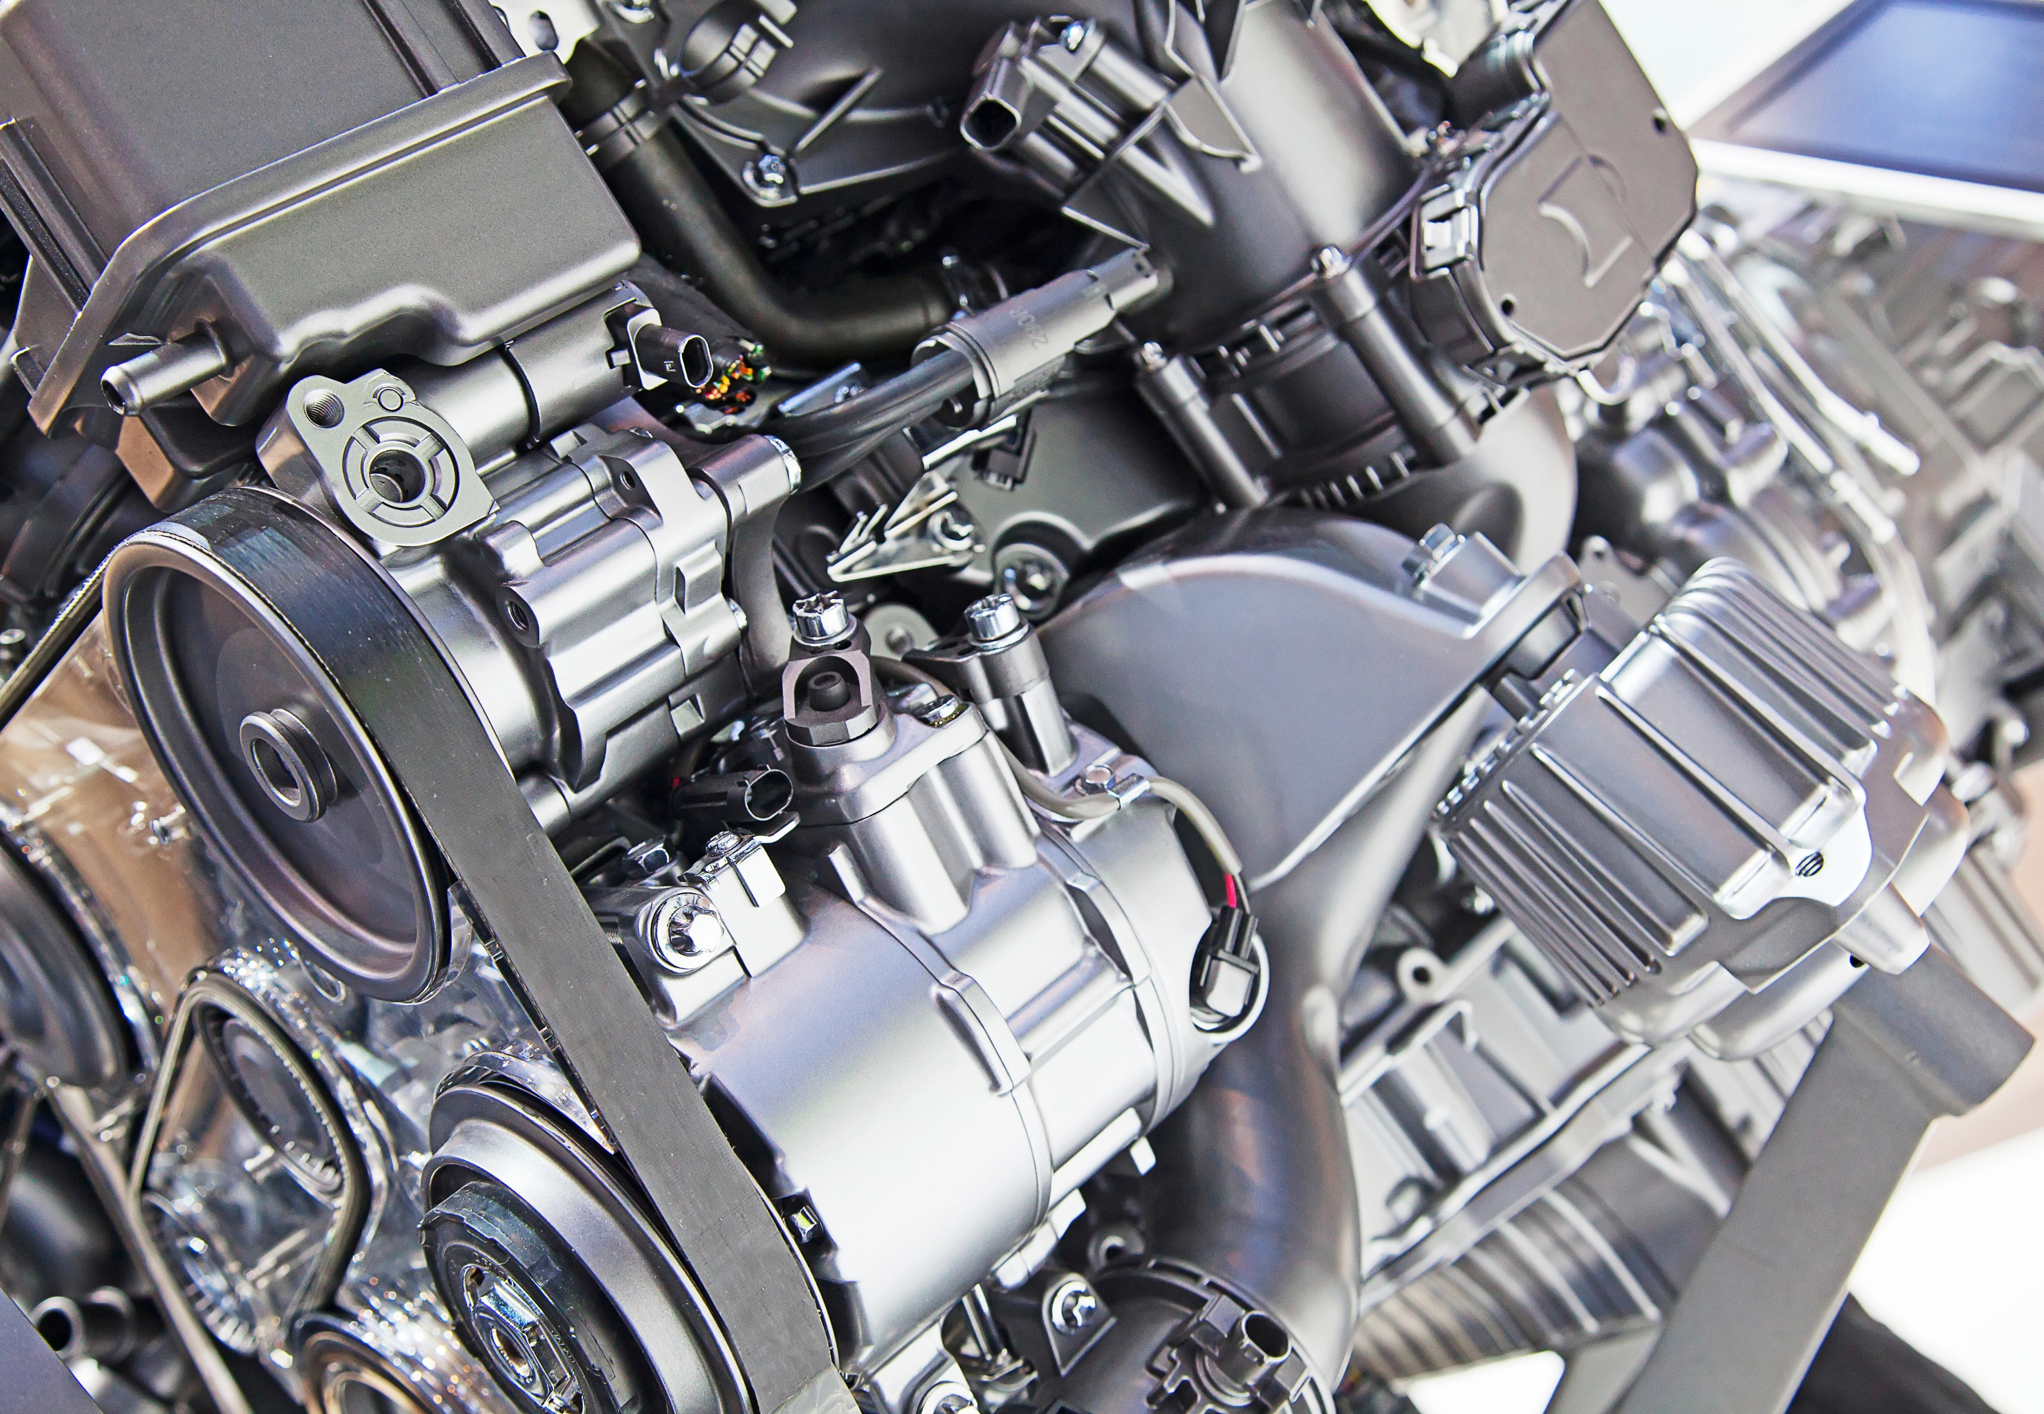





Gen AI for Mobility Regulatory Doc
Client was looking for a solution to analyze automotive regulation documents. Some of the key challenges included classification of documents as safety relevant or not which are often time consuming and error prone
Developed a GenAI powered solution to classify whether its functional safety relevant or not. The solution also semantically matches the context with the requirements available and extracts the safety requirements.
Reduced the lead time for from 30hrs to <2hrs
Improved productivity and turn around time
Helped reduce / eliminate errors
Notes:
BU: Mobility Electronics (ME)
Plants: CljP, JuP, NhP1
Line Type: SMT
Product Team: PT-SMT
Data: Productivity (Utilization, Downtimes, Cycle Times, Parts Produced)

Slide 20


ProCodex Functional Safety
Solution Flow Diagram
Language Classification Model
Is Duplicate Document?
Is Document in English ?
Is Safety Relevant?
No
Classification Model
Duplicate Check Algorithm
Yes
No
Classifies as Non-Safety Relevant
Safety
Document
Yes
Provides Document Relevancy – High, Medium or Low
Yes
Flags as Duplicate – No further processing required
Requirement Extraction Algorithm
Extracted requirements shown in UI
All requirements available as a downloadable excel
Requirements Database from PCLP Tool
Provides Classification Score

Slide 21




Gen AI for Intelligent Diagnosis
The problem centers around finding an efficient method to analyze customer-reported issues from verbatim feedback and deliver accurate, data-driven recommendations to technicians, streamlining the repair and maintenance process for improved speed and precision..
Developed a Gen AI based application that accepts customer verbatims and recommends the top 3 possible causes along with recommendations to fix the issues
Accelerated service of cars by up-to 30%
Reduced turn around time for vehicles in the workshop
Improved customer satisfaction
Notes:
BU: Mobility Electronics (ME)
Plants: CljP, JuP, NhP1
Line Type: SMT
Product Team: PT-SMT
Data: Productivity (Utilization, Downtimes, Cycle Times, Parts Produced)

Slide 22
Mahindra VoC NLP Flow
VoC System Flow (NLP)
Google NMT API
no
Text Verbatim
Is Eng
yes
Verbatim Group Classification
Verbatim Code Mapping
English Text Verbatim
Start
Voice Verbatim( Whatsapp)
Google STT API
Text Verbatim
User Safety Group Classification
Dynamic Conditional Questions
Payload:
Verbatim group, Summary
Update Response
User Response
Labor code, Description
Part number, Description
yes
Update
Summary
Probability Score
Probability Score
no
Summary
END
VoC Flow (User Verbatim to Labor/Part Mapping)

Slide 23

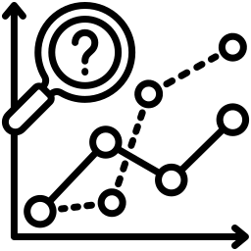

Revolutionizing IT Onboarding with Generative AI
Gen-AI-powered system designed to streamline IT onboarding by reducing manual intervention and enhancing engagement with visual aids. It minimizes repetitive tasks, allowing teams to focus on strategic initiatives while ensuring seamless knowledge transfer.
Developed Generative AI solution that :-
Retrieves data from Confluence pages and documents stored in SharePoint, ensuring quick and easy access to relevant information.
Makes onboarding a more intuitive / interactive experience.
On-premises deployment, making it ideal for enterprises handling sensitive information Secure.
Secure with on prem deployment
Multiple Data Sources integration
Accelerates productivity
Enhanced efficiency and superior user experience

Slide 24
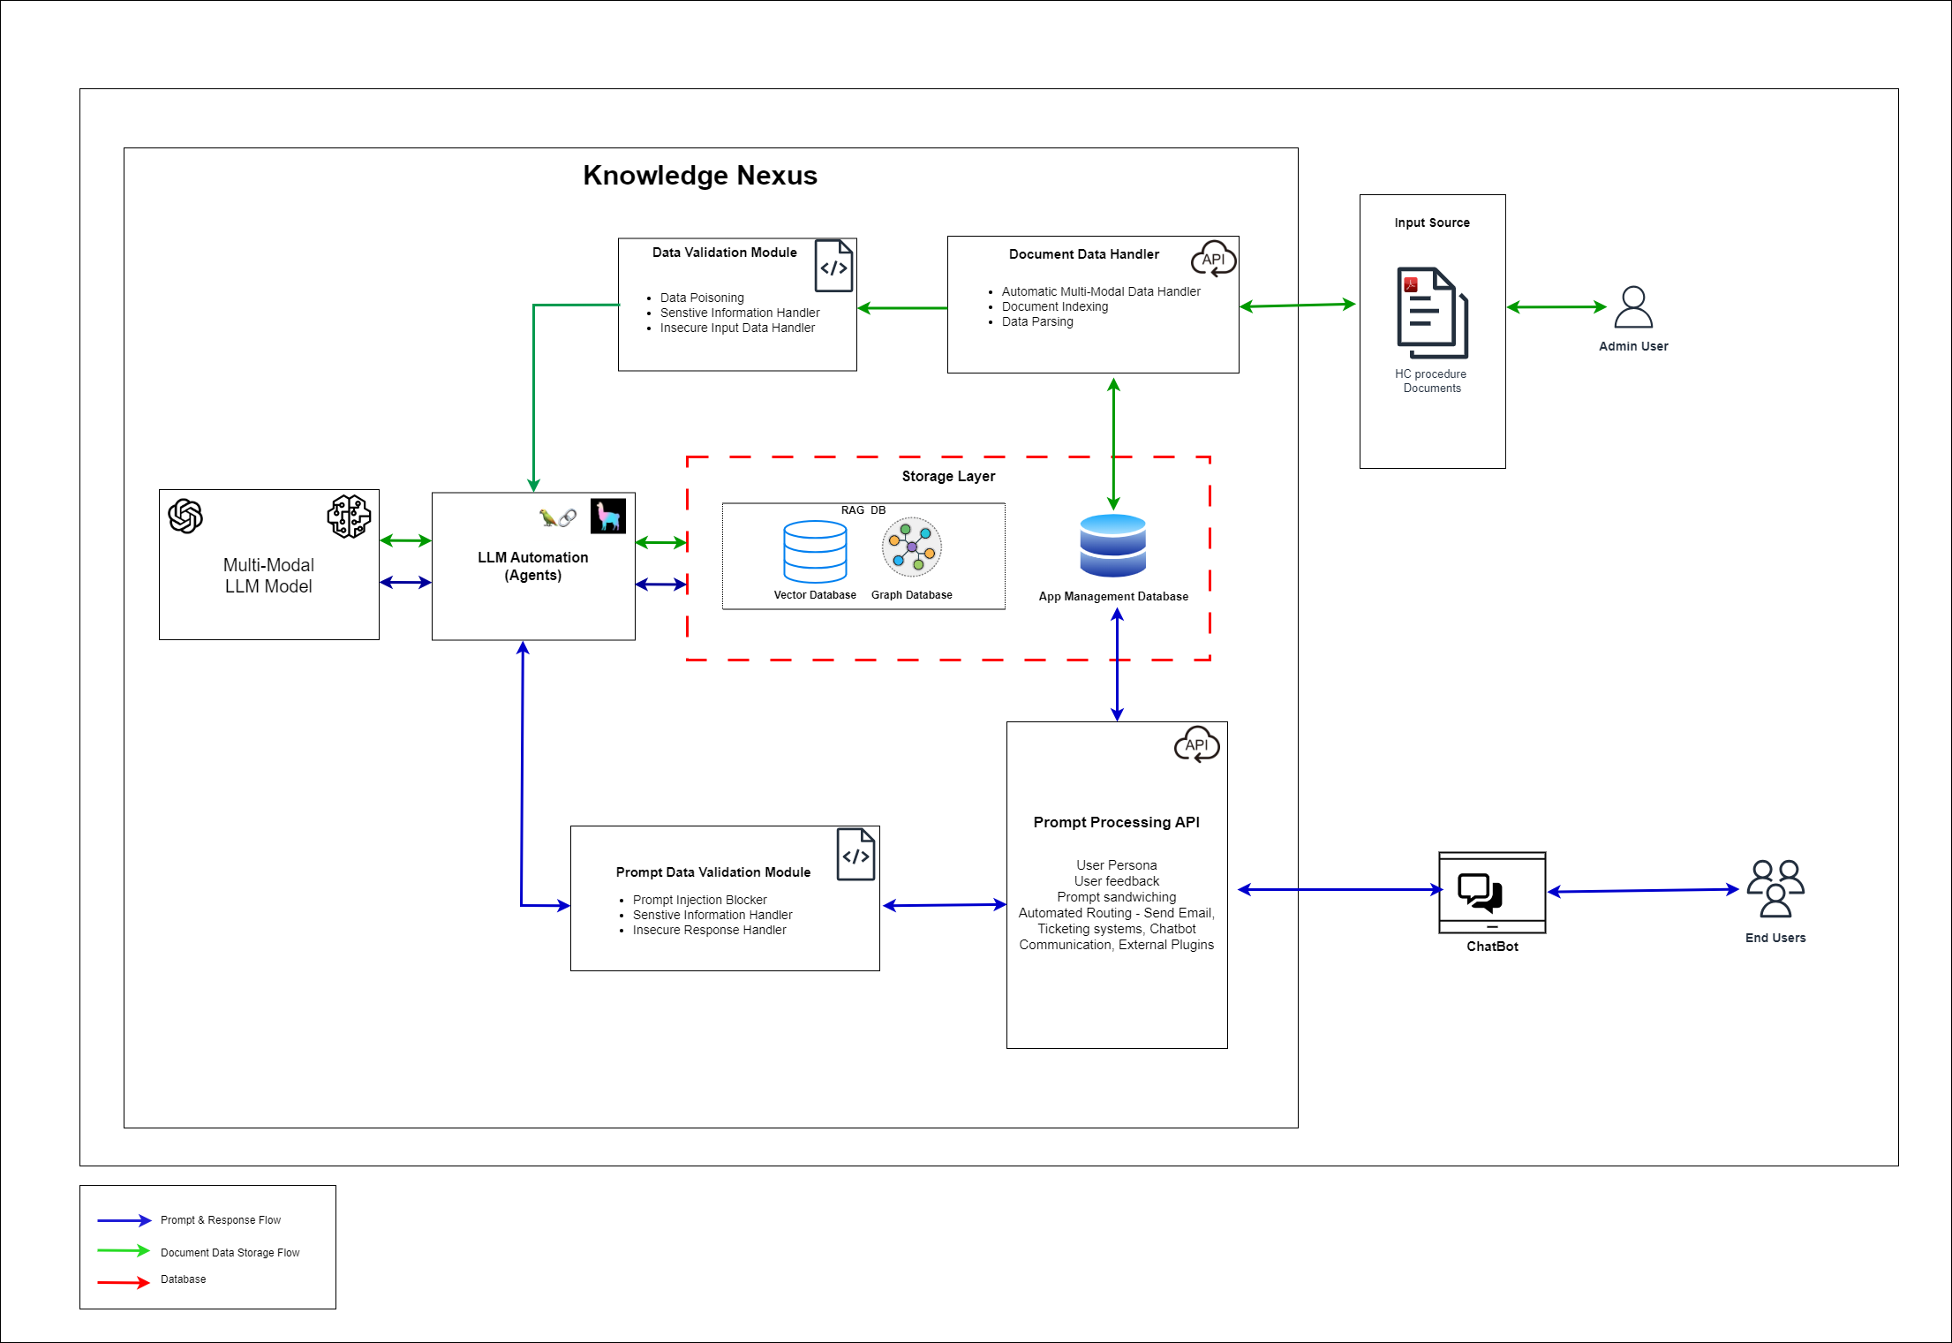
Frames Architecture

Slide 25
Expedited Pharma R&D using Gen AI
Sifting through Pharmacopeia documents is a time consuming and effort intensive task for R&D associates. Client was looking to harness the power of Gen AI for a contextual chatbot, smart summarization and document comparisons.
Developed an OpenAI based application that enabled client to streamline their R&D process with the faster TAT and reduced errors.
Trained over 100+ Pharmacopeia documents
Efforts needed to analyze the documents are expected to be down by 90%
Enabled quick references to regulatory documents
Notes:
BU: Mobility Electronics (ME)
Plants: CljP, JuP, NhP1
Line Type: SMT
Product Team: PT-SMT
Data: Productivity (Utilization, Downtimes, Cycle Times, Parts Produced)

Slide 26




MiDAS: MISRA Code Compliance Assist
Challenge: Ensuring compliance with MISRA guidelines can be complex and time-consuming, often resulting in delays in project timelines and increased risk of errors.
Client Need: A solution to automate the assessment and enforcement of MISRA code compliance to enhance development efficiency
Solution: Developed a GEN AI tool that:-
Automatically assesses code for MISRA compliance, identifying potential errors/violations in real-time.
Provides intelligent recommendations for code corrections and best practices to enhance compliance.
Streamlined compliance processes
Improved Code Quality improved overall code quality while saving valuable time.
Reduced development risks
BSH

Slide 27
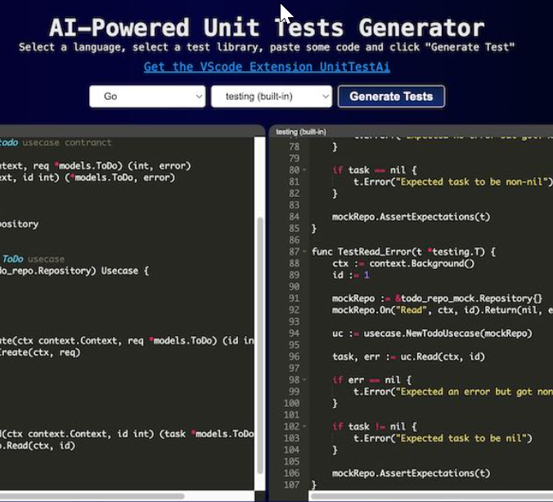

MiDAS: Code To Unit Test Assist
Challenge: Writing unit tests for code is often a time-consuming and manual task, leading to delays in development and testing cycles.
Client Need: A solution to automate the generation of unit tests from code to enhance efficiency and accuracy.
Solution: Developed a GEN AI tool that:-
Automatically generates unit tests from existing code with contextual understanding.
Improves test coverage and reduces manual effort by providing intelligent suggestions.
Accelerated development cycles
Improved Code Quality and time to deployment by over 50%
Reduce time spent on manual test creation
HC
BCI
BHCS

Slide 28









Synthetic Data Generation and Image Enhancement
Client needed a solution to monitor the live status of food being cooked in a microwave oven, where high temperature and moisture made image deblurring challenging.
Applied GANs to synthetically generate images with various types of blurs and used these to enhance and restore images by removing blur.
Achieved SSIM score of 0.92 and PSNR value of 35.57 for image deblurring
Overcame data limitations by augmenting images to train the model effectively
Utilized attention GANs to create diverse blur types and enhance image quality
Generated over 3500 quality synthetic images from 1606 original images
Notes:
Skim through

Slide 29











Image Labelling using Gen AI
Client was looking an accelerated development cycle for autonomous off-highway vehicles. To start with, client was looking for an automated image labelling technique for machine learning datasets.
Developed an automated image annotation technique leveraging Azure AI Vision Service along with attribute extraction leveraging GPT-4
Developed more than 10,000 labelled images within 2 months
Faster development life-cycle
Automated annotation with 20+ properties
30+ object tagging with 6+ custom prompt creation
Notes:
Skim through

Slide 30


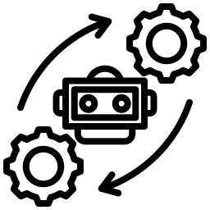

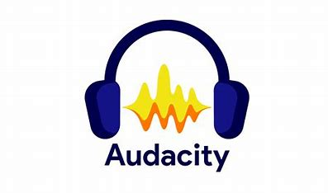



Ride Buddy: Audio based Event detection
An end-to-end advanced audio-based event detection AI solution, designed to enhance safety in corporate mobility. By leveraging cutting-edge sound analysis, it ensures proactive monitoring and swift response to critical events.
Developed an audio-based event detection model using Machine learning that will ensure accurate and timely detection of vehicle events.
Detected vehicle events with an accuracy of ~90%
Enhanced safety,
Non-intrusive monitoring,
Cost-effective,
Reliable and pro-active incident management 24/7

Slide 31



IndAIGenious – Gen AI for Industries
In the dynamic world of manufacturing, line managers are the linchpins of operational efficiency. From managing production schedules to ensuring quality control and troubleshooting issues on the fly, line managers face an array of challenges that can impact the overall productivity
Ind.GenAI is a Gen AI solution designed to transform the role of line managers by enhancing decision-making through a series of intelligent recommendations
Predict potential issues before they arise
Data-driven insights to assist line managers in making informed decisions
Minimizes downtime through intelligent troubleshooting
Notes:
https://etlgenaimanufacturing.azurewebsites.net/
https://www.google.com/chrome/what-you-make-of-it/
BU: Mobility Electronics (ME)
Plants: CljP, JuP, NhP1
Line Type: SMT
Product Team: PT-SMT
Data: Productivity (Utilization, Downtimes, Cycle Times, Parts Produced)

Slide 32

Gen AI for Dynamic Production KPIs
In the traditional approach, deriving KPIs from production data across multiple plants involved data extraction along with statistical analysis to fetch the results. Client was looking for a self-service tool to generate KPIs on demand across Utilization, Interruptions, Cycle time and Change over.
Developed a GenAI powered solution with data injection capability from multiple platforms along with the ability to perform statistical analysis
Enabled self service KPI generation like Operational Equipment Effectiveness
Low code/ no code for easy configuration of multiple LLM agents
Reduced/ eliminated the need of Data Analyst teams
Notes:
BU: Mobility Electronics (ME)
Plants: CljP, JuP, NhP1
Line Type: SMT
Product Team: PT-SMT
Data: Productivity (Utilization, Downtimes, Cycle Times, Parts Produced)

Slide 33
Responsible AI

Slide 34
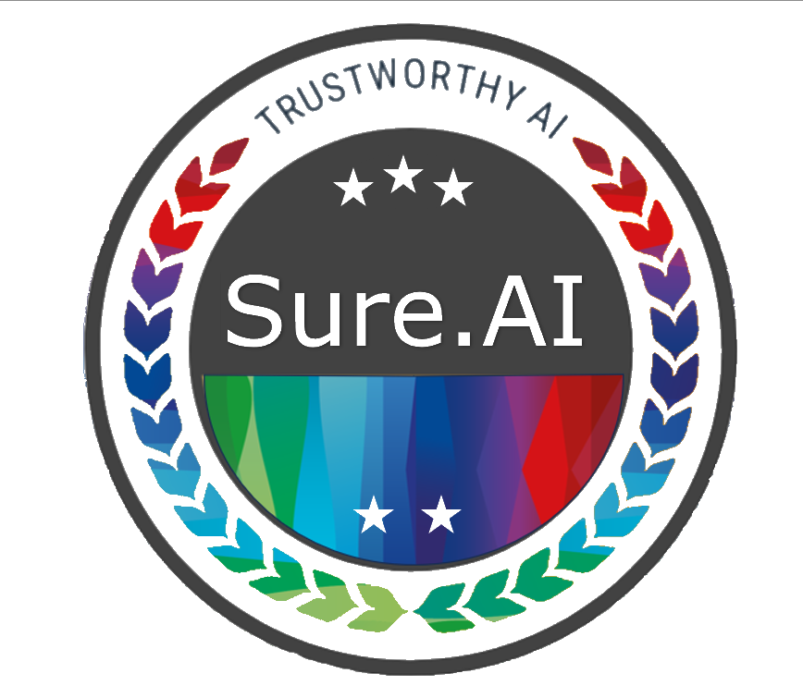











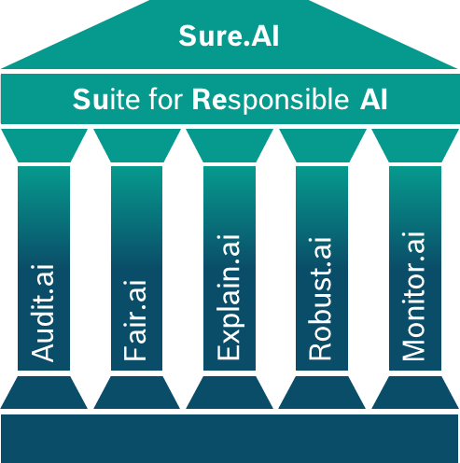
Sure.AI for Responsible AI: Now is the time
With AI penetrating through geographies, industries and functions, risks associated with AI are increasing in frequency and severity.
An AI system now needs to be ethical and trustworthy by proving that it is fair, explainable, accurate, safe, robust and aligned with regulations.
WHY?
Real world examples
Regulations worldwide
Framework from Trustworthy AI*
Unsafe AI
Lawful
Ethical
Robust
Tesla’s self driving car collided with emergency vehicles
Self-driving-car algorithms may have a racism problem
Wrong
Right
Penalty
Respect all applicable laws & regulations
Respect the ethical principles
and values
Be robust technically & within scope of social environment
7% of violator’s global turnover or € 35M+ as per EU rule
Unfair AI
European AI Act
US Algorithm
Accountability Act
GDPR
Risk score for black offenders higher compared to whites.
Twice as many false positive prediction for recidivism for black offenders than white - Jeff Larson Article
2023
2020
2019 revised 2023
Audits as per
regulations
Human Autonomy
Explainable
Resilient to
adversarial attack
Lack of Explainability in AI
Damage
Legal &
Compliance
experts
Safe
Fair
Reliable
&
Reproducible
Accurate
Stanford’s state-of-the-art skin cancer detection AI initially matched human performance but was later found to falsely tag images with rulers as malignant.
to Brand & Business
Un-trustworthy AI systems prove fatal for brand & legal positioning
NIST
ISO/IEC 42001
Indian principles & regulations
2023
2023
2024 Expected
WHAT?
Sure.AI: Suite For Responsible AI
Value created
End-to-end workflow platform for Responsible AI from ideation to deployment, beyond. Generates a Unified report capturing performance & traceability across the AI product.
Audit.AI
Generate a holistic evaluation report of AI models, data
Check compliance to AI laws, policies
Diversify your portfolio efficiently
Platform Demo
Fair.AI
Assess & avoid hidden ethical biases in AI models
Increase end-user’s trust in bias critical systems
Audit.AI: Ensure Regulatory compliance of AI products
Compliance Checker
Explain.AI
Enable transparency & trust in your AI models
Explain unforeseen predictions of your AI model
Increase product adoption by offering predictions + explanations
Fair.AI: Unbiased predictions, independent of race ethnicity
Chat Companion
Explain.AI: Explainable, Traceable by humans in the loop
Robust.AI
Stress-testing your models with challenging inputs
Increase product scalability across environments
Robust.AI: Reliable, Reproducible outcomes under stress testing
Monitor.AI: Avoid data and model poisoning in the real-world
Monitor.AI
Avoid sudden surprises of model performance post-production
Keep data drifts on check
Avoid customer churning due to unexplained performance dips
GenAI

Slide 35










Responsible GenAI – Acts and Institutions
National AI Strategy (AI for All)
Leveraging AI to boost economic
growth and innovation
UK AI Regulation
Bias, Fairness and
Ethical Guidelines
Artificial Intelligence and Data Act
Transparency and
Human Rights Protection
EU Artificial Intelligence Act (AI Act)
Transparency, Risk management
and Accountability
White House AI Bill of Rights (U.S.)
Safe and Effective AI System
Cyberspace Administration of China
Algorithm Transparency and
Content Regulation
National Institute of Standards and Technology (NIST)
Standards for Trustworthy AI systems
Global AI Ethics and Governance Observatory (unesco.org)
Ethical AI development
https://owasp.org/
Risk Management and Security of AI systems
Standardization, evaluation, and transparency of AI language models:
FMTI: Foundation Model Transparency Index (stanford.edu)
HELM: Holistic Evaluation of Language Models (HELM) (stanford.edu)
RAGAS: Metrics | Ragas

Slide 36
VisionSmart.AI

Slide 37
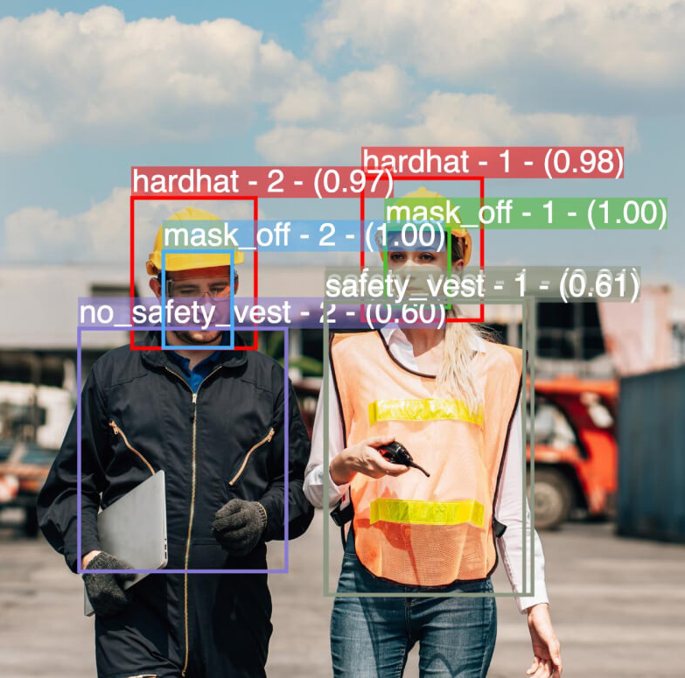






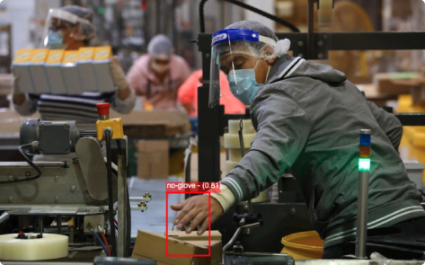




VisionSmart.AI – E2E CV Platform for Industries
The VisionSmart.AI platform revolutionizes computer vision management by leveraging advanced image AI algorithms and offering exceptional versatility across various use cases.
Seamlessly integrating with existing systems, it effectively tackles critical quality control & safety challenges across the diverse industry sectors.
Multiple Vision Use Cases
Real time Alerts
Annotation on-the-Fly
Hardware & Cloud Agnostic
User Friendly
Data Driven Insights
Notes:
BU: Mobility Electronics (ME)
Plants: CljP, JuP, NhP1
Line Type: SMT
Product Team: PT-SMT
Data: Productivity (Utilization, Downtimes, Cycle Times, Parts Produced)

Slide 38










































VisionSmart.AI
A Unified AI Vision Platform for accelerated Image Analysis and Insight Generation.
BOSCH VisionSMART.AI
Piecemeal Vision Solutions
Manufacturing
Tool B(Analytics)
Unified AI Vision Platform for any Domain
Tool A(VQI)
Tool C
(Intrusion Detection)
Anomaly Detection
Assembly Assistance
3D Recons
Tool D(Alerts)
Healthcare
Tool E(Camera feed)
Alerts & Analytics
Intrusion Detection
PPE Detection
Face Detection
VisionSmart.AI offers a full suite of tools for every step of AI Vision workflow
Security
Pre-Trained Model Templates
Inference & Visualize
Target Object
Sensing Device
Data Processing
Dynamically Train & Retrain Models
Alerts & Call to Action
Retail
DIY Workflows
Usecase Acquisition
Enrich Datasets
Model WorkBench
Inference & Alert
Do-it-Yourself
VisionSmart effortlessly integrates with the infrastructure to acquire new vision use cases.
Enhance datasets with Smart annotations and 2D/3D data augmentation.
Pre-trained Model Templates for quick use , and custom model training with few shot learning.
Instantly detect Object and Anomalies, proactive threat prevention through real-time alerts.
Manage entire workflow and devices through a user-friendly Low-Code/No Code Interface.
38

Slide 39
AI case studies and Open Discussions

Slide 40




Visual Quality Inspection
Quality Inspection was an error prone and cost intensive process for client often leading to product replacements and recalls. Client was looking for an automated solution using AI that can offset this challenge.
Developed a deep learning-based model to detect micro-level defects (up to 1mm) with an ability to scale into multiple scenarios.
Client reported an improved accuracy by 40%
Eliminated manual inspection, false rejects and human intervention
Accelerated production process (less than 5 secs per inspection)

Slide 41
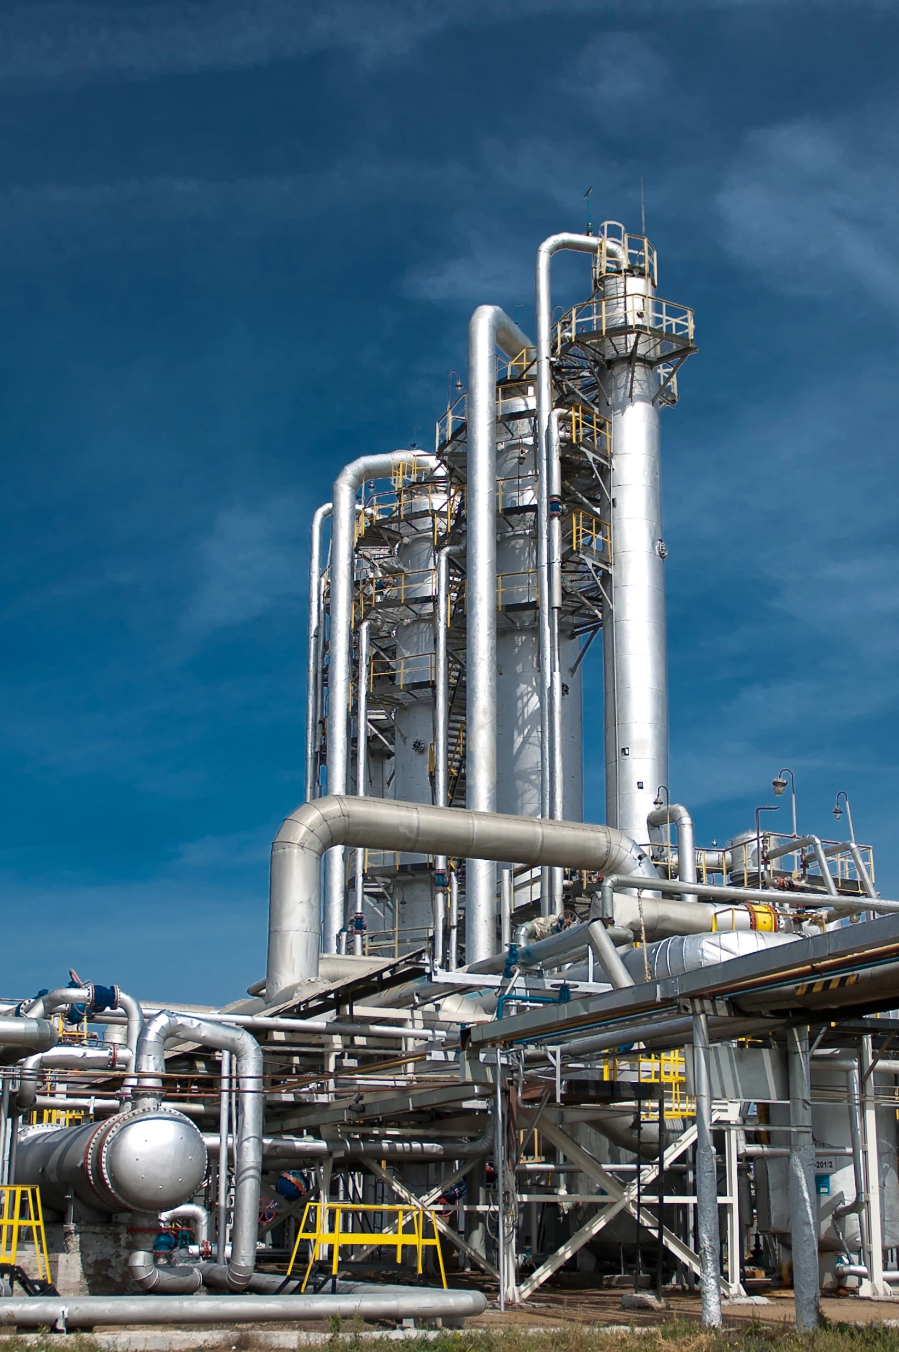




Predictive AI for MFG Assets
Client had multiple critical assets like pumps, gas turbines and cooling fans. Cavitation and erosion in pump impeller, wear of thrust and journal bearing in gas turbine intermittently causes operational impact and business loss.
Developed AI based solution for Real time analytics, Condition Monitoring, Machine Insights, System Alerts and more
Reduce Unplanned maintenance costs
Connected to 370+ assets across multiple plants
Minimized downtime across plants by 18%
Automated messages/alerts for abnormal behaviors

Slide 42




Predictive AI for Electric Oil Pumps
Electric Oil Pumps are a critical component in trucks and any abrupt failure can disrupt supply chains. VHIT was looking for a low-cost AI based solution that can detect failures in advance and prevent downtimes.
Implemented deep learning-based models that enables holistic view of asset functioning from the simulated data collected using 52 virtual sensors
Preventive actions helped reduced maintenance cost
Edge AI with minimal or zero cloud connectivity
Reduced downtime by 26% ensuring trust and reliance on the fleet of trucks
Deployed over fleet of 15000 trucks

Slide 43
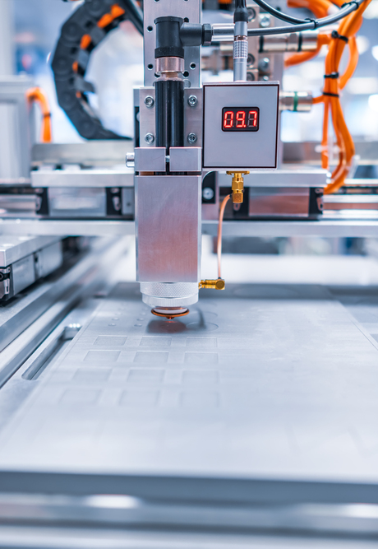







Real-time Cycle Time Monitoring
Client was looking for a diagnostic solution to identify bottlenecks in production line, thereby improving the utilization
Developed a cycle time monitoring solution leveraging data lake solution by ingesting machine data from MES. Developed multiple dashboards and KPIs for improved visibility.
Proposed production of upto 20000 additional parts per month
Improved utilization by 18%
Rolled out to 13 plants, covering 275+ Production Lines

Slide 44




AI Enabled Scrap Reduction
Client wanted to reduce scrap rate in wheel production by predicting scrap wheel based on process parameters used for wheel production
Prescribed more than 10 recipes for good wheel production by deploying predictive AI models leveraging data from PLC and sensors such as temperature, pressure and cooling time data, wheel types and more
Reduced the scrap rate from 2.9% to 1.3% (60% reduction)
Periodic update of wheel production recipe considering new incoming data
Highly accurate model (~95%) ensuring customer success
Notes:
Wheel type and furnace type based recipe models
10k wheels / day -> reduced from 290 to 130 defects

Slide 45





AI Aided Customer Support
Client wanted to reduce/eliminate human intervention during email clearance process as a part of their Customer Information Center(CIC) operations
Developed an NLP based engine to classify emails and direct to the respective service queues. Enabled automated handling of attachments, identification of duplicate emails, automatic response and extraction of customer information
Reduced the avg handling time by 90% from 3 mins to 20 secs
Reduce costly manual CIC operations along with operational efficiency
Handled 45,000 emails monthly

Slide 46
THANK YOU
Notes:
Scrap reduction – Recipe recommendation (can relate to

